Slide 1
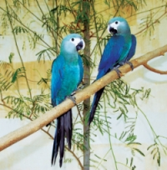
spix’s macaw
Endangered species assignment

Slide 2
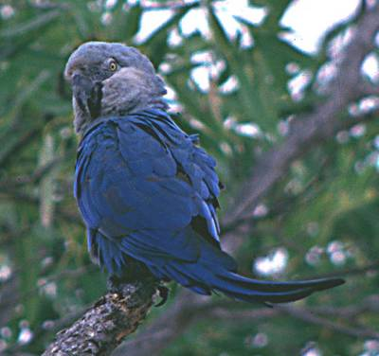
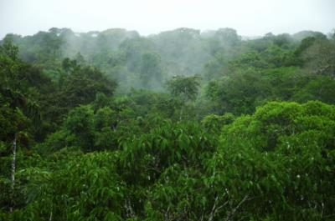
habitat
In the wild the spix’s macaw lives in brazil witch is in south America.
It lives in places that are abundant in tall canopy trees and contain plants wich have lots of berries, seeds and nuts.(the amazon rain forest).

Slide 3
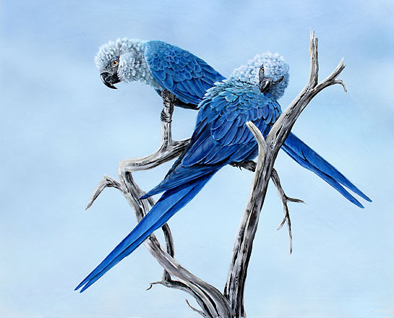
appearance
The bird is one of the smaller macaws.
It weighs about 300 grams .
It’s plumage is various shades of blue. It has a blue body and a blue and gray head.
Females are a bit smaller than males.

Slide 4
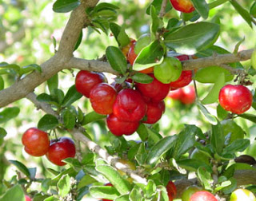
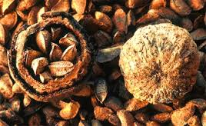
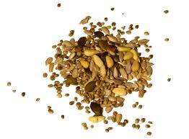
diet
The spin’s macaw is a hebivor.
In the wild It eats seeds, nuts and berries.

Slide 5
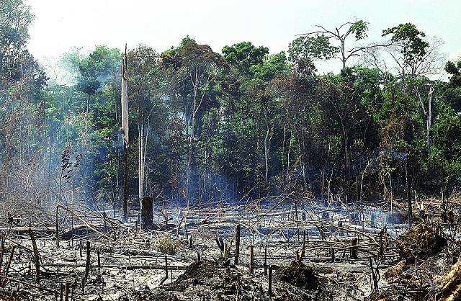
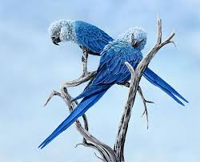
Endangered
captivate Spix’s macaw is critically endangered and it is extinct it the wild
The last wild Spix’s macaw was a male that died in 2000.
The species is now maintained through captive breading programs like Al Wabra wide life preservation center. It has 55 birds out of the 88 living in captivity.
Over hunting and destruction of the amazon rain forest (habitat loss) has made the Spix’s macaw endangered.

Slide 6
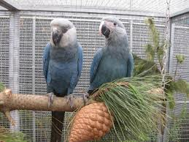
How to help to spix’s macaw
We can help the spix’s macaw by not supporting things that are made from wood from the amazon rain forest
Not hunt animals for fun (game hunting)
Donate to breeding programs like the al wabra wild life preservation center .

Slide 7
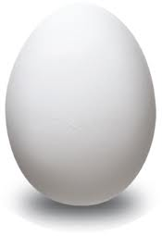
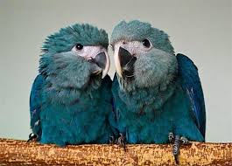
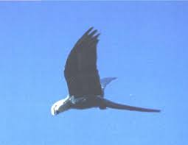
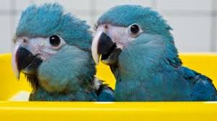
Awesome facts!!!!!!!!!!!!
the spix’s macaws scientific name is cyanopsitta spixii. (try saying that 10 times fast!)
The spix’s macaw can live up to 60 years!!!
The spix macaw is also known as “the little blue macaw”.
Spix’s macaw babies are really cute (I don’t if that’s a fact)
Spix’s macaw eggs are only 1 cm wide and 5 cm long!

Slide 8
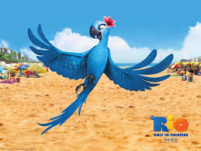
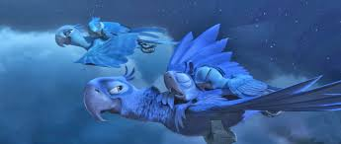
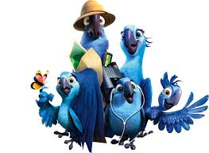
Spix’s in Hollywood
Did you know that “RIO” was based on the spix’s macaw!!!!!(he he he bet you never knew that.)

Slide 9
By: Aamina Anjum (the awesomest person on earth)
Bibliography :,
http://www.youtube.com/watch?v=JsKH49L6dh0
http://www.arkive.org/spixs-macaw/cyanopsitta-spixii/ ,
http://en.wikipedia.org/wiki/Spix%27s_macaw.
Pics from Google pics

