Slide 1
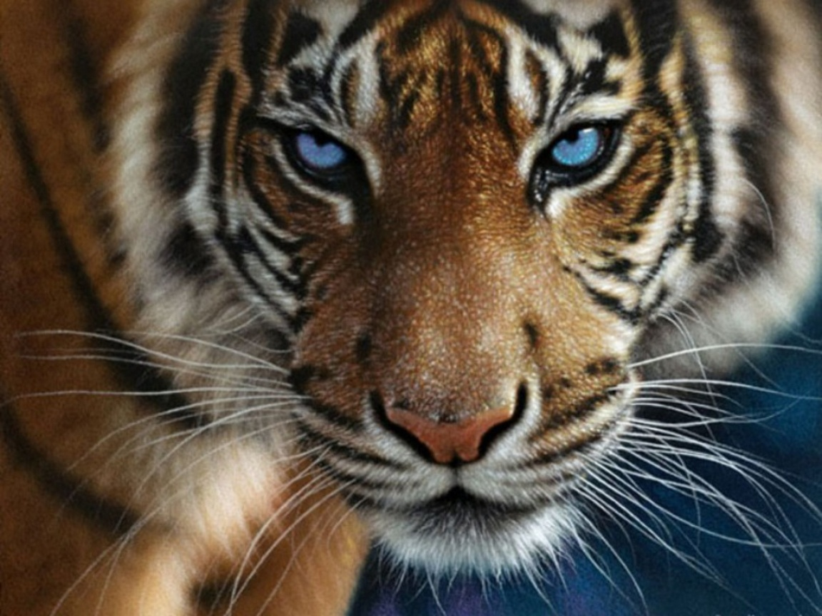
THE BENGAL TIGER
(Panthera tigris tigris)
By: Adeel Haq

Slide 2
Description Of The Bengal Tiger
Male Bengal tigers have the average length of 270 cm- 310 cm while females are 240 - 270 cm. Males weigh 400-500 pounds and females weigh 200-350 pounds. Each tiger wears a different coat of fur. The stripes on the fur will never match another tiger’s strips. That is a small description on it.

Slide 3
Habitat:
The Bengal tigers’ habitat is dense forests, mangrove swamps and jungles.
Their prey can be found in these areas which is why the tiger makes its home here.
The Bengal tigers’ territory can be up to 120 square kilometers. That is the habitat of the Bengal tiger.

Slide 4
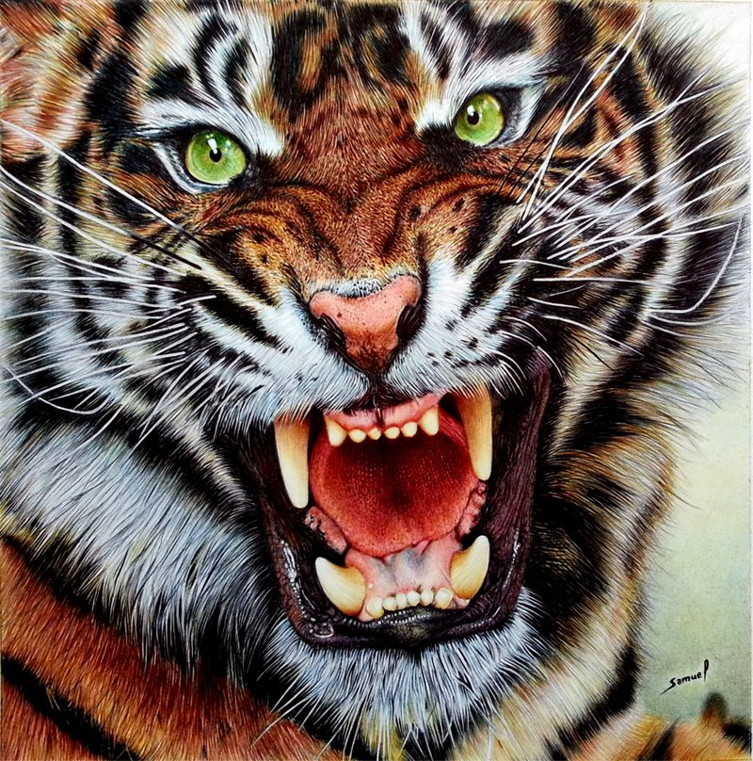
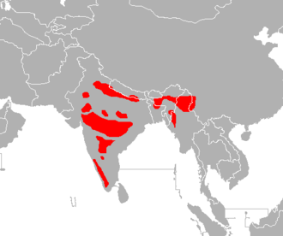
Country:
The continent in which the Bengal tiger lives in is Asia. The countries in Asia where the Bengal tiger populates most is in India, Bangladesh, Bhutan, and Nepal. The Bengal tiger lives in the forests where there prey lives.

Slide 5
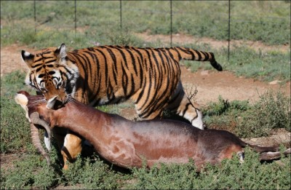
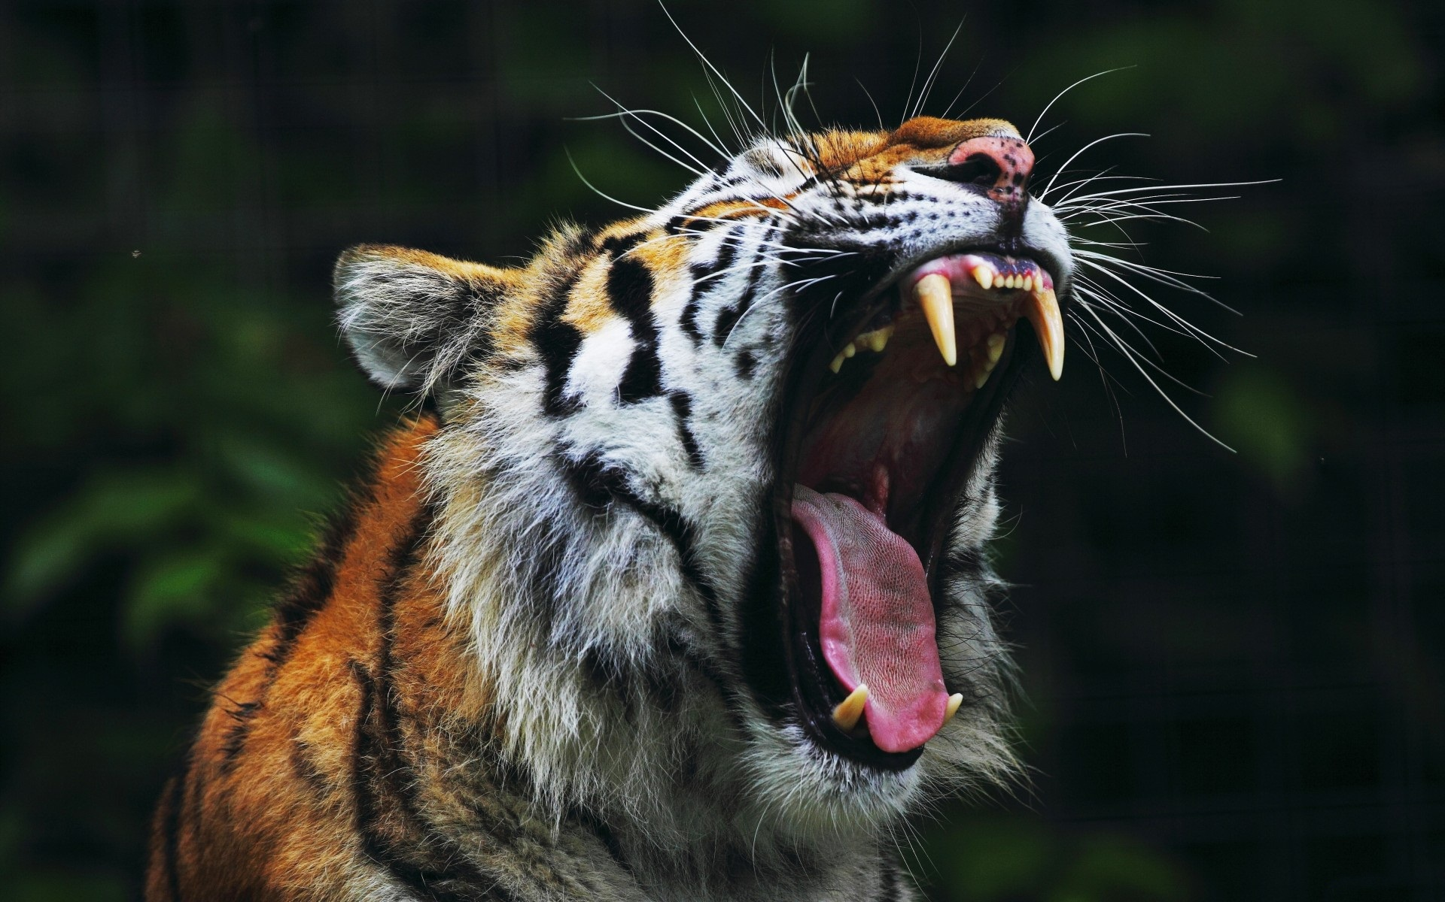
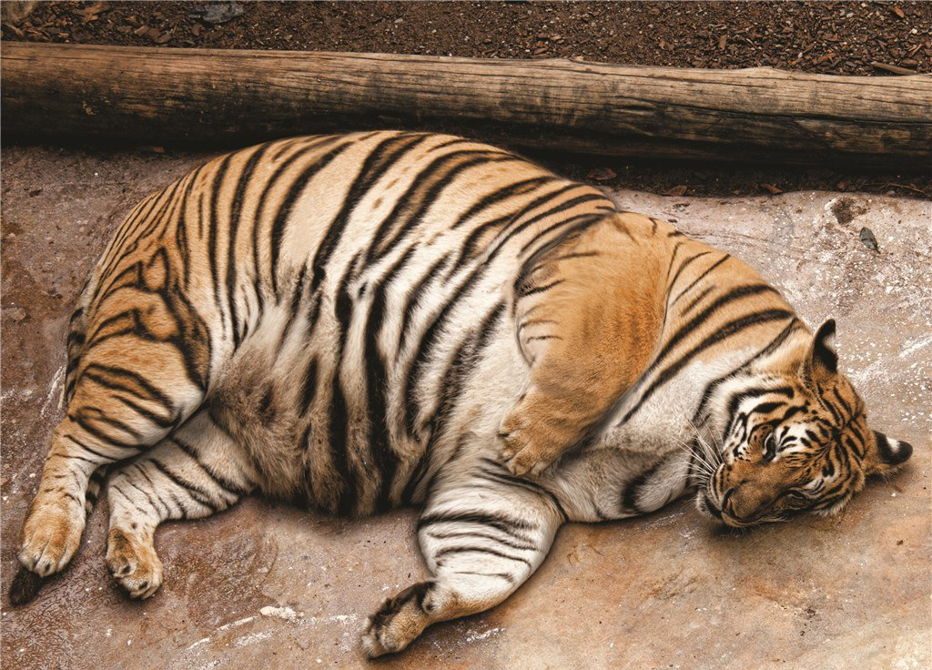
Interesting Facts:
1. The roar of the Bengal
tiger can be heard two miles away.
2. Tigers can easily jump 6 m in length and 5 m straight in the air.
3. Tigers can eat up 60 pounds of food. That is about 200 burgers to us.

Slide 6
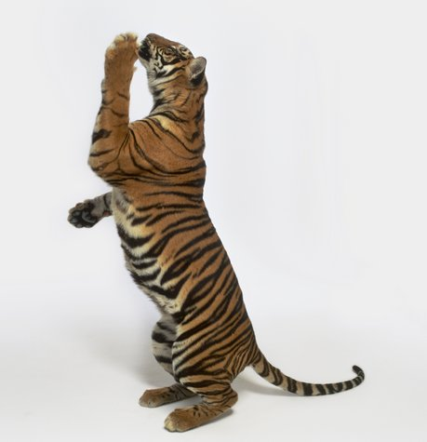
Continued:
4. Most tigers (including the Bengal tiger) have the chinese mark of “king,” on their forehead.
5. A tiger’s muscles are so strong that if it were to die standing, it would remain upright even thought it was dead.

Slide 7
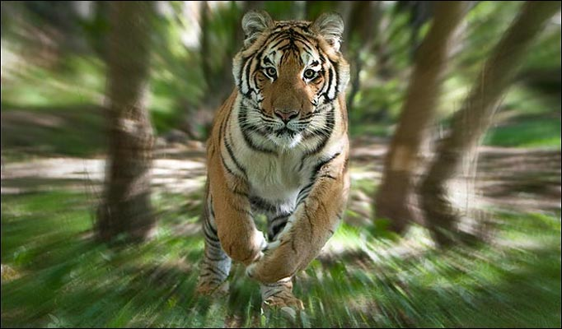
The Bengal tiger is endangered for two main reasons. One reason is poaching. Many people in the world would love to have tiger skin. Because of the high demand for this product, people illegally hunt for tiger skin.
Some people eat tiger body parts. So people buy tiger meat to eat. That is one reason it is endangered.
Why The Bengal Tiger Is Endangered:

Slide 8
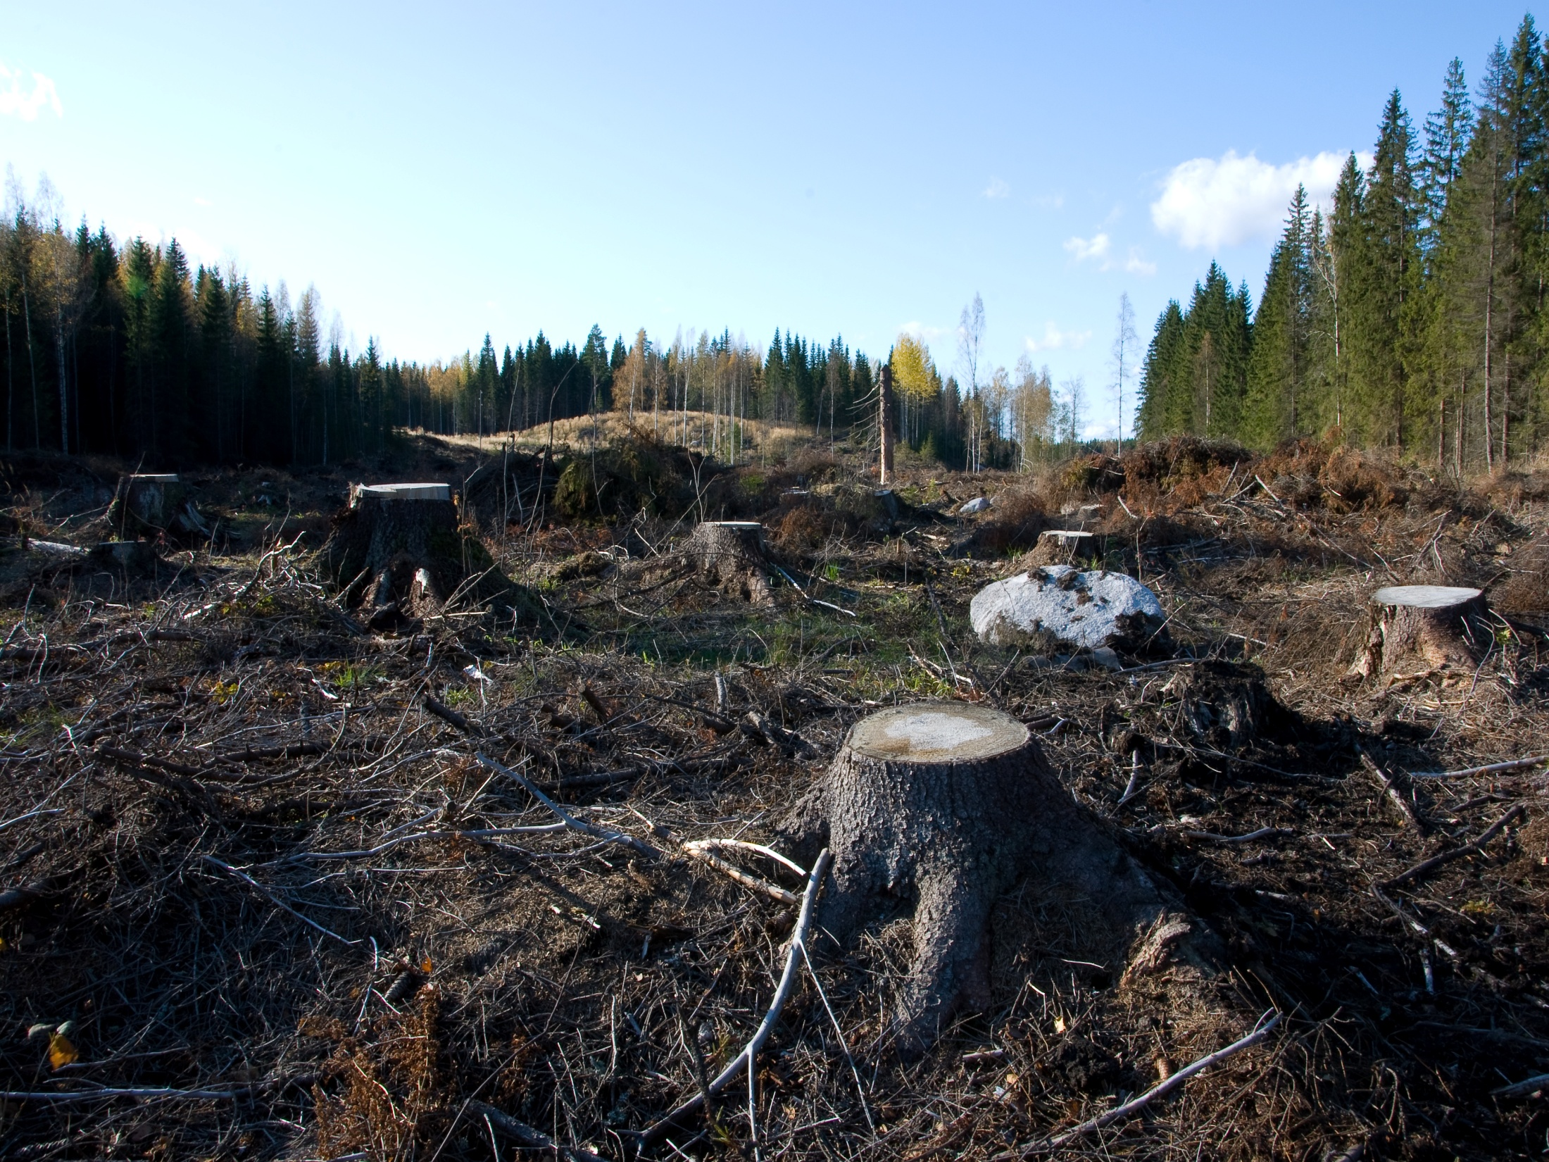
Continued:
A second reason that the Bengal tiger is endangered is because of Urbanization. When forests are cut down, the Bengal tiger loses its habitat and it results in death. Urbanization also affects the tiger`s prey for example, deer. When the deer die because of Urbanization, the deer also loses its home and begins to die. Without prey, the Bengal tiger will not survive.

Slide 9
What People Can Do To Save The Bengal Tiger:
To help save the Bengal tiger, people can do three easy things. One thing people can do is to stop buying tiger fur. When nobody buys it, the hunters will stop killing the tigers because nobody wants it.

Slide 10
Continued:
Another way you could save the Bengal Tiger is by not cutting down trees or limit the amount cut.
This is because habitat is one of the populations main declining factor. When we stop destroying their habitat, then the Bengal tiger may come out of the danger of extinction.

Slide 11
Continued:
My last way people could save the Bengal tiger is by building more conservation parks for it.
When the tigers can live peacefully away from poaching and habitat destruction, they can reproduce more tiger cubs. That is a few ways we can all help to save the Bengal tiger.
Thanks For Listening
You Were an excellent audience
By: Adeel Haq

