Slide 1
THE NORTHERN SPOTTED OWL
BY FATIMA MAHMOOD GR.7B

Slide 2
OVERVIEW
Habitat
Diet
Location
Facts
Cause of endangerment
What we can do

Slide 3
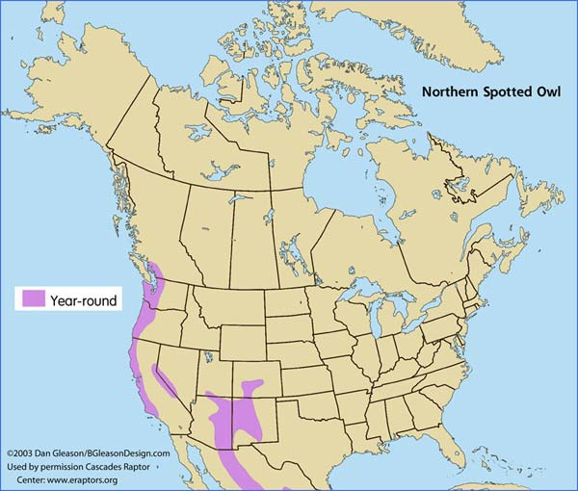
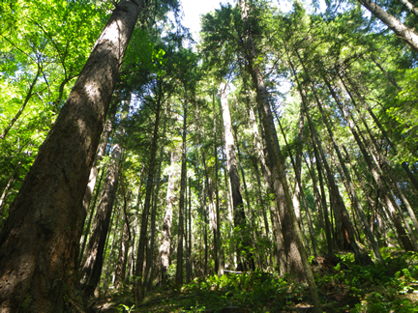
HABITAT
They inhabit old growth forests in the northern part of its range (Canada to southern Oregon)
Also inhabit landscapes with a mix of old and younger forest types.

Slide 4
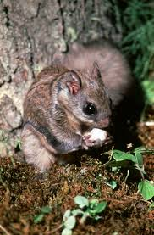
WHAT IT EATS
Their prey consists of small mammals like:
flying squirrels
wood rats
hares and rabbits
They eat mice and moles in the summer
Also like to eat their prey whole (bones, skulls, teeth and fur are commonly seen in owl pellets)

Slide 5
WHERE ITS LOCATED
They are unique to North America.
In Canada, they only live in southwestern British Columbia.
It is believed that fewer than 11 pairs remain in B.C.
In USA, they can be found in Washington, Oregon, California, Utah, Colorado and Arizona.

Slide 6
INTERESTING FACTS
They're one of the few owls with dark-colored eyes. Most other owls have yellow to red-orange colored eyes.
They don’t migrate for the winter.
They may live up to 17 years.
They don't build there own nests, instead they take over other birds nests high in the trees.

Slide 7
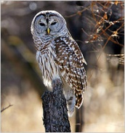
WHY ITS ENDANGERED
Because the owls prefer old-growth forests, they are heavily affected by clear-cut logging.
In the past, experts estimate there were 500 spotted owl pairs living in southwestern B.C
Today, only about a dozen remain in the province, largely due to loss of habitat.

Slide 8
WHY ITS ENDANGERED
An invasive species the barred owl, who is more aggressive and larger I n size in the soaring old-growth evergreens of Washington, Oregon and California where spotted owls nest and hunt. They are also a threat .
BARRED OWL

Slide 9
WHAT PEOPLE CAN DO
People can help by :
“Adopting an animal”
Becoming an advocate
Staying informed
And taking direct action by speaking directly to officials.

Slide 10
SOURCES
http://www.defenders.org
http://www.theweathernetwork.com
http://www.canadiangeographic.ca
http://www.nytimes.com
http://naturemappingfoundation.org
http://en.wikipedia.org
http://education.nationalgeographic.com

