Slide 1
Buckle you seat belts for we are going to discover a whole different world of leopards and our threats to them.

Slide 2
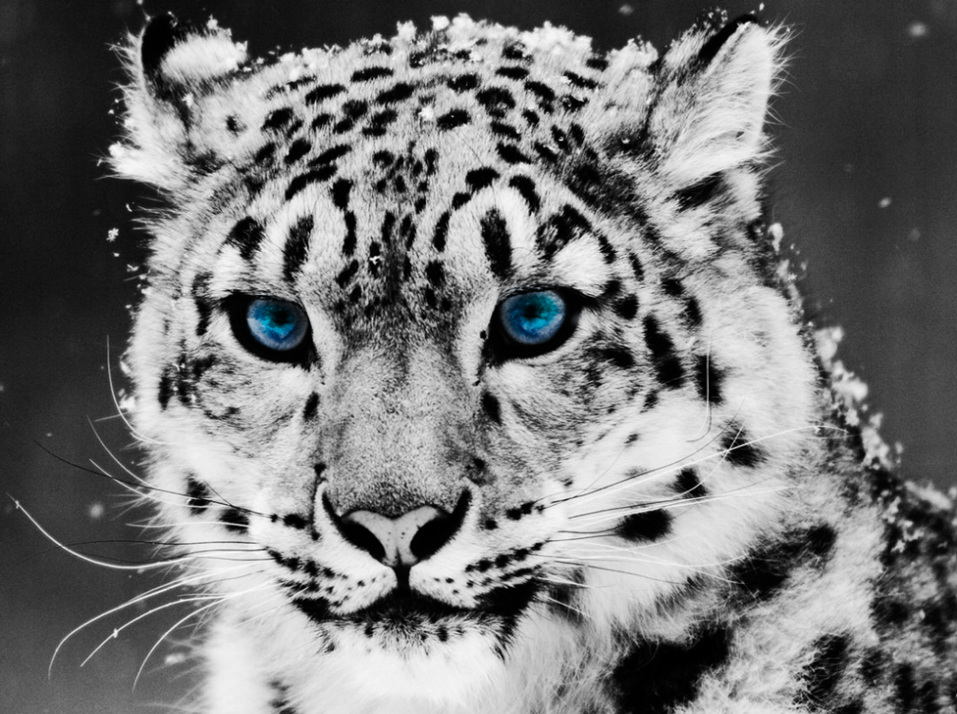
Snow Leopards
Snow leopard are an endangered animal and will be extinct if we don’t help. Lets mend our hands and give them a life we would want ourselves!

Slide 3
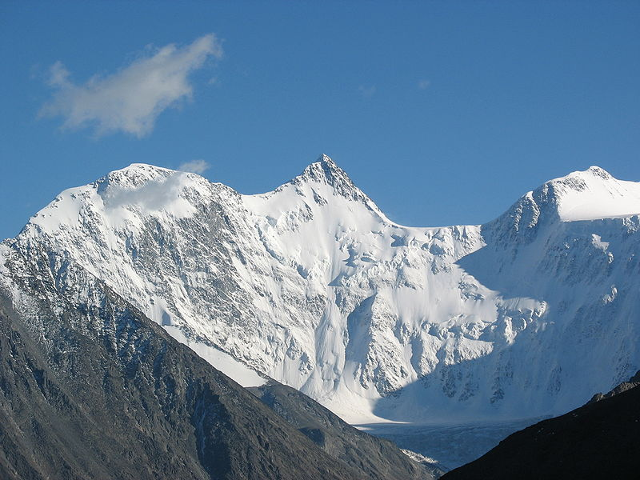
Habitat
  Snow leopards are found at altitudes between 9,800 and 17,000 feet in the high, rugged mountains of Central Asia

Slide 4
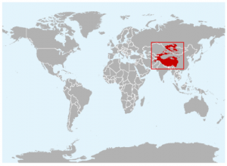
Origin of Country
Their range spans from Afghanistan to Kazakistan and Russia in the north to India and China in the east. China contains about 60% of snow leopard habitat.

Slide 5
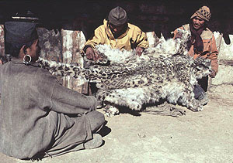
Cause of Endangerment I
The many reason the snow leopards are endangered is because of humans capturing them for their fashionable skin. We kill them and take their coat for our fashion needs.

Slide 6
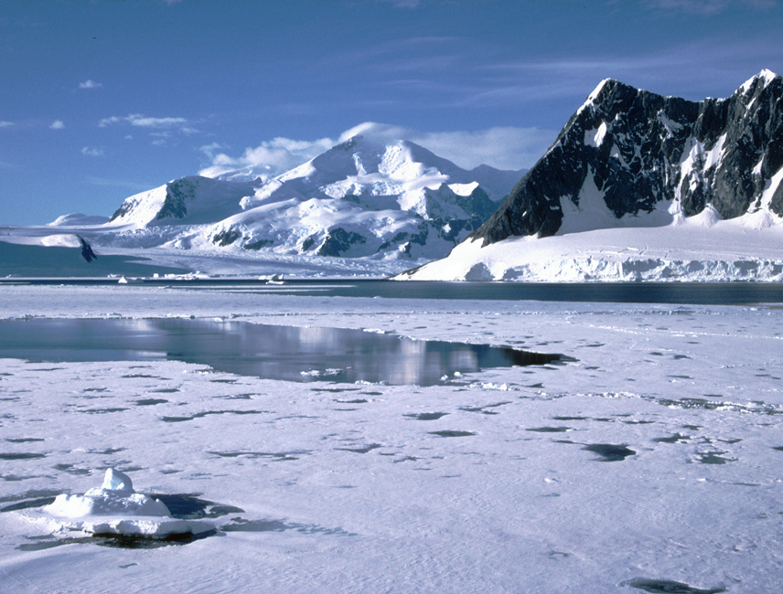
Cause of Endangerment II
Climate change is also the cause of snow leopard endangerment. Since climate change brings down the temperature, the snow lines are withdrawing, which send the leopard higher up the mountains. As the proceed higher up, the vegetation runs low which causes the prey to run low which involves in hard time finding food.

Slide 7

Helpful Humans
We can help save the snow leopards by contributing to the organizations that support snow leopards such as WWF(world wide fund). We can also help by showing awareness for the hunting of snow leopards. If we stop hunting then we stop losing snow leopards. Also if we stop polluting which is causing global warming, then we won’t need to move the leopards higher into the mountains where they have no prey to feast on. We can make a difference, one person at time.

Slide 8
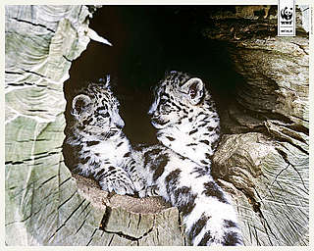
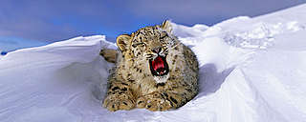
Fun Facts
Snow leopards are born in fur lined dens
Snow leopards can’t roar!

Slide 9
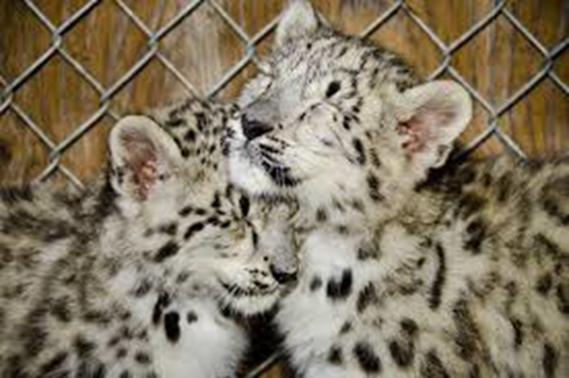
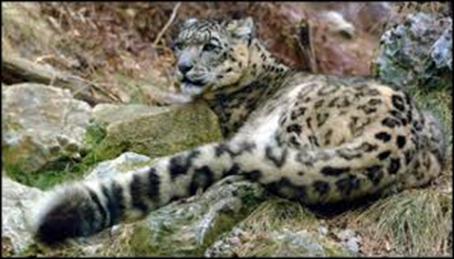
Fun facts
are born blind!
Their tails are as long as they are

Slide 10
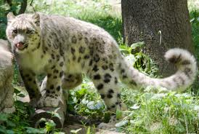
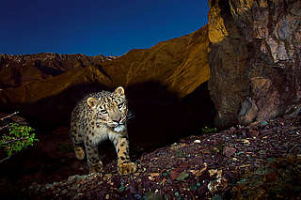
Fun facts
Advertise their presence by scraping boulders with their claws.
They hunt animals three times their size

Slide 11
Work cited page
wwf.ca/
www.wwf.org.uk › Wildlife
hubpages.com › ... › Life Sciences › Endangered Species
en.wikipedia.org/wiki/Snow_leopard
www.defenders.org/snow-leopard/threats
www.google images.com

Slide 12
Hope you enjoyed you trip! Thanks for coming!
~Firdous Fatima Kareemuddin
7B

