Slide 1
The Black Panther

Slide 2
18/10/14

Slide 3
Scientific name Panthera pardus

Slide 4
The Black Panther is a melanistic color variant of the leopard.

Slide 5
The animal lives in the wild, mostly in Australia. Their population is decreasing day by day. Sadly, only 85 – 90 remain in the world.

Slide 6
The animal lives in a den, similar to a lion’s den, but more hidden away into the forest.

Slide 7
Facts

Slide 8
Shockingly, the Black Panther is the same thing as a leopard, just the skin is melanistic (the panther was born that way).

Slide 9
Panther is known as black jaguar in South America, as black leopard in Asia and Africa, and as black cougar in North America

Slide 10
An adult Panther is 7-8 feet in length and weighs between 100-250 pounds.

Slide 11
In the wild, Panthers can live up to 12 years, and in captivity up to 20

Slide 12
A Panther can leap up to 20 feet (6.06 meters)

Slide 13
Since there are only 85 to 90 left, one square meter of fur from this animal could cost up to $ 400,000. Some really rich poachers are hunting this animal for their fur. Due to this, they are becoming endangered. Around 45 are being kept in animal care institutions, but even this won’t help when it’s too late.

Slide 14
One way humans can protect these animals is to stop illegal poaching. By doing this, we can raise their number significantly.

Slide 15
Another way that humans can help is to stop gas pollution. This can also help greatly.

Slide 16
Finally, some farmers who live near the area should stop setting poison gas traps and even spring attack traps.

Slide 17
Now, for the pictures...

Slide 18
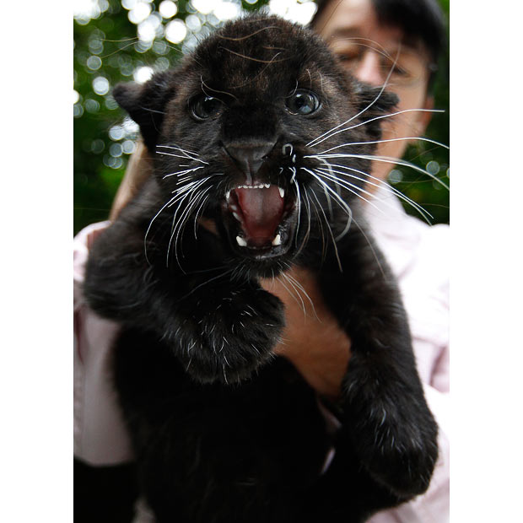

Slide 19
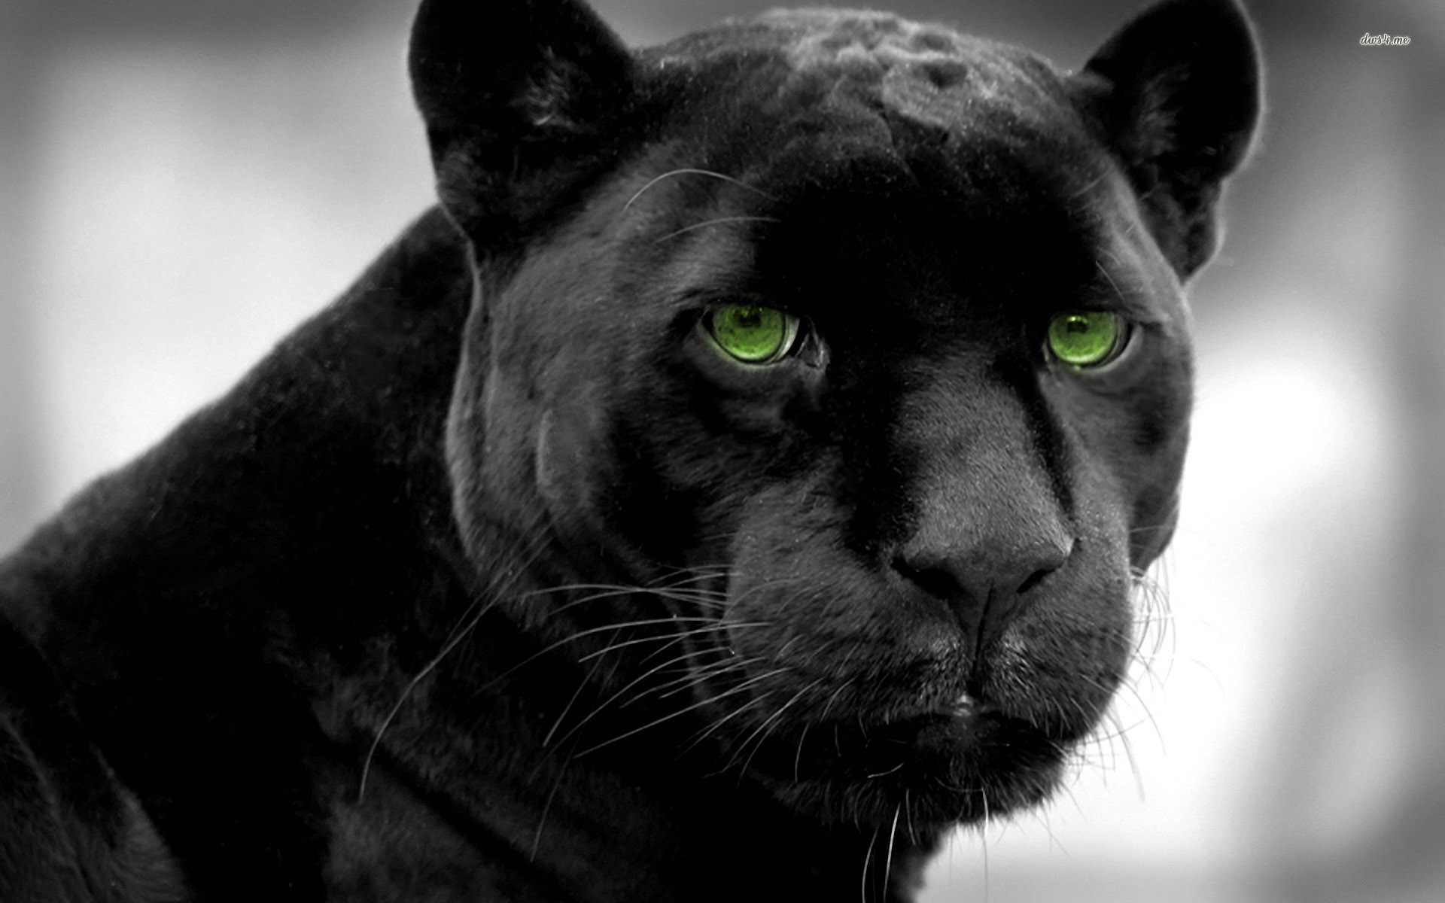

Slide 20
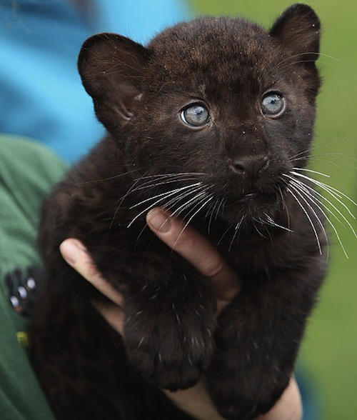

Slide 21
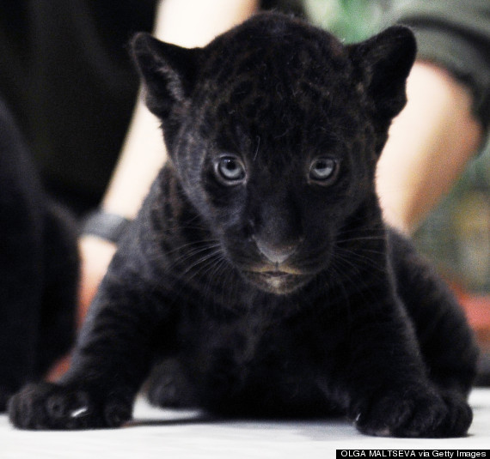

Slide 22
I hope you enjoyed the presentation.

Slide 23
Thank You

