Slide 1
Bengal Tigers
By: Mohabatullah Mohammedi
Grade: 7B
Teacher: Sr. Nilab
Subject: Science Topic: endangered species

Slide 2
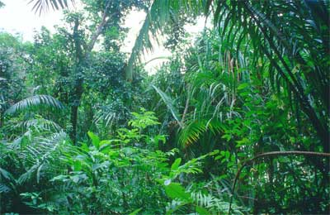
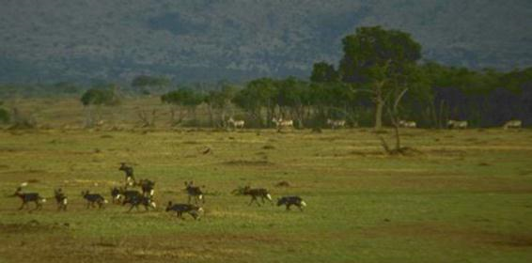
Bengal Tigers habitat
Natural Habitats:
Grasslands
Subtropical and Tropical rainforests
Scrub forests
Wet and dry deciduous

Slide 3
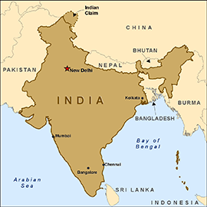
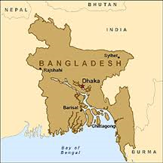
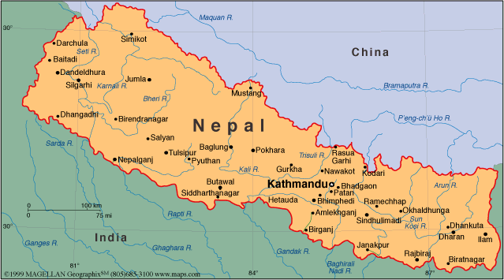
Bengal Tigers National Countries
Where is it found:
Bangladesh
India
Nepal
Bhutan

Slide 4
Interesting Facts About Bengal Tigers
Interesting facts:
2,500-3,000 Bengal tigers total population
Since 2010 has been endangered
Male average length 270-310 cm female average 240-265
Bengal tigers kill animals twice its size
Became an important of Indian tradition

Slide 5
What has caused bangle tiger to be endangered?
Why are they endangered:
for their valuable coat
use some body parts as weapons
try to defend them selves

Slide 6
3 ways people can save Bangle Tigers
Ways people can save animals:
stop cutting trees/ deforestation
stop polluting
maintain bio diversity

