Slide 1
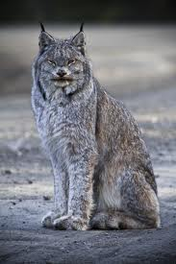
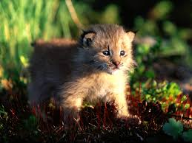
THE CANADIAN LYNX
BY OMAR ELSEKELY

Slide 2
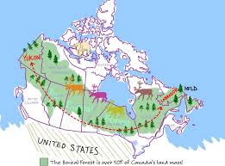
WHAT IS THE LYNX’ HABITAT?
Boreal Forest Belt of North America
Canada from Newfoundland to the Yukon Territory
Alaska & Northern United States
Their dens are under fallen trees, tree stumps, rock ledges and thick bushes

Slide 3
INTERESTING FACTS
Member of the cat family
In Winter fur is thick and grey
In summer fur is thinner and light brown
Main source of food is the snowshoe hare
Other food sources = small mammals, birds and small caribou
One lynx may consume 200 snowshoe hares in one year

Slide 4
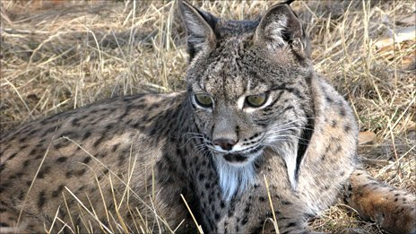
More Interesting Facts
More active at night
Can spot a mouse at 200 feet away
Like to hunt alone (not in groups)
Males live alone except during mating
season in the winter

Slide 5
WHAT HAS CAUSED THIS ANIMAL TO BECOME ENDANGERED?
THE LYNX is hunted by:
Wolves
Cougars
Coyotes
HUMANS
…but its biggest predator would be

Slide 6
Humans are the BIGGEST THREAT
Where are they supposed to go? How are they supposed to survive?
they don’t …that’s why there are only
70 left in the world
Population declined because of fur trade
People set traps to catch lynx for their fur
Forests have been destroyed for:
1) logging
2) road building
3) housing development
4) resources (trees)

Slide 7
WHAT CAN PEOPLE DO TO HELP SAVE THE LYNX?
Protest (government buildings)
Take action (internet …blogs etc.)
Donate (ie. Big Cat Rescue)

Slide 8
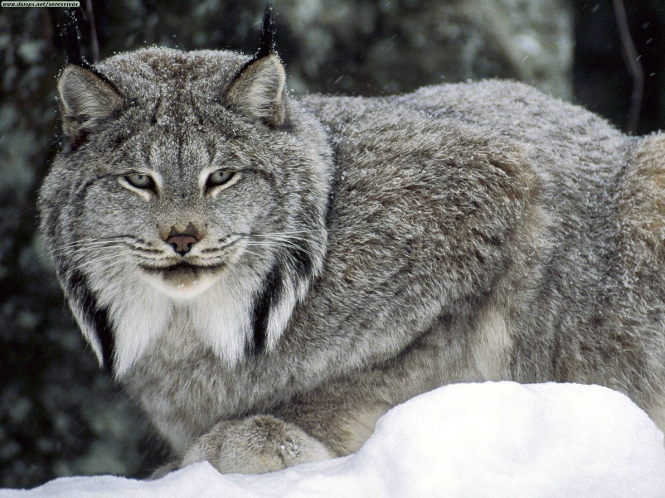
THE END

