Slide 1
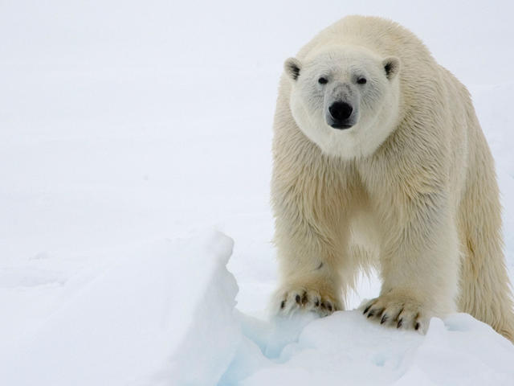
Polar bears
Polar bears
Are we ready to say good bye to the polar bears!
Or are we going to help and protect these amazing animals

Slide 2
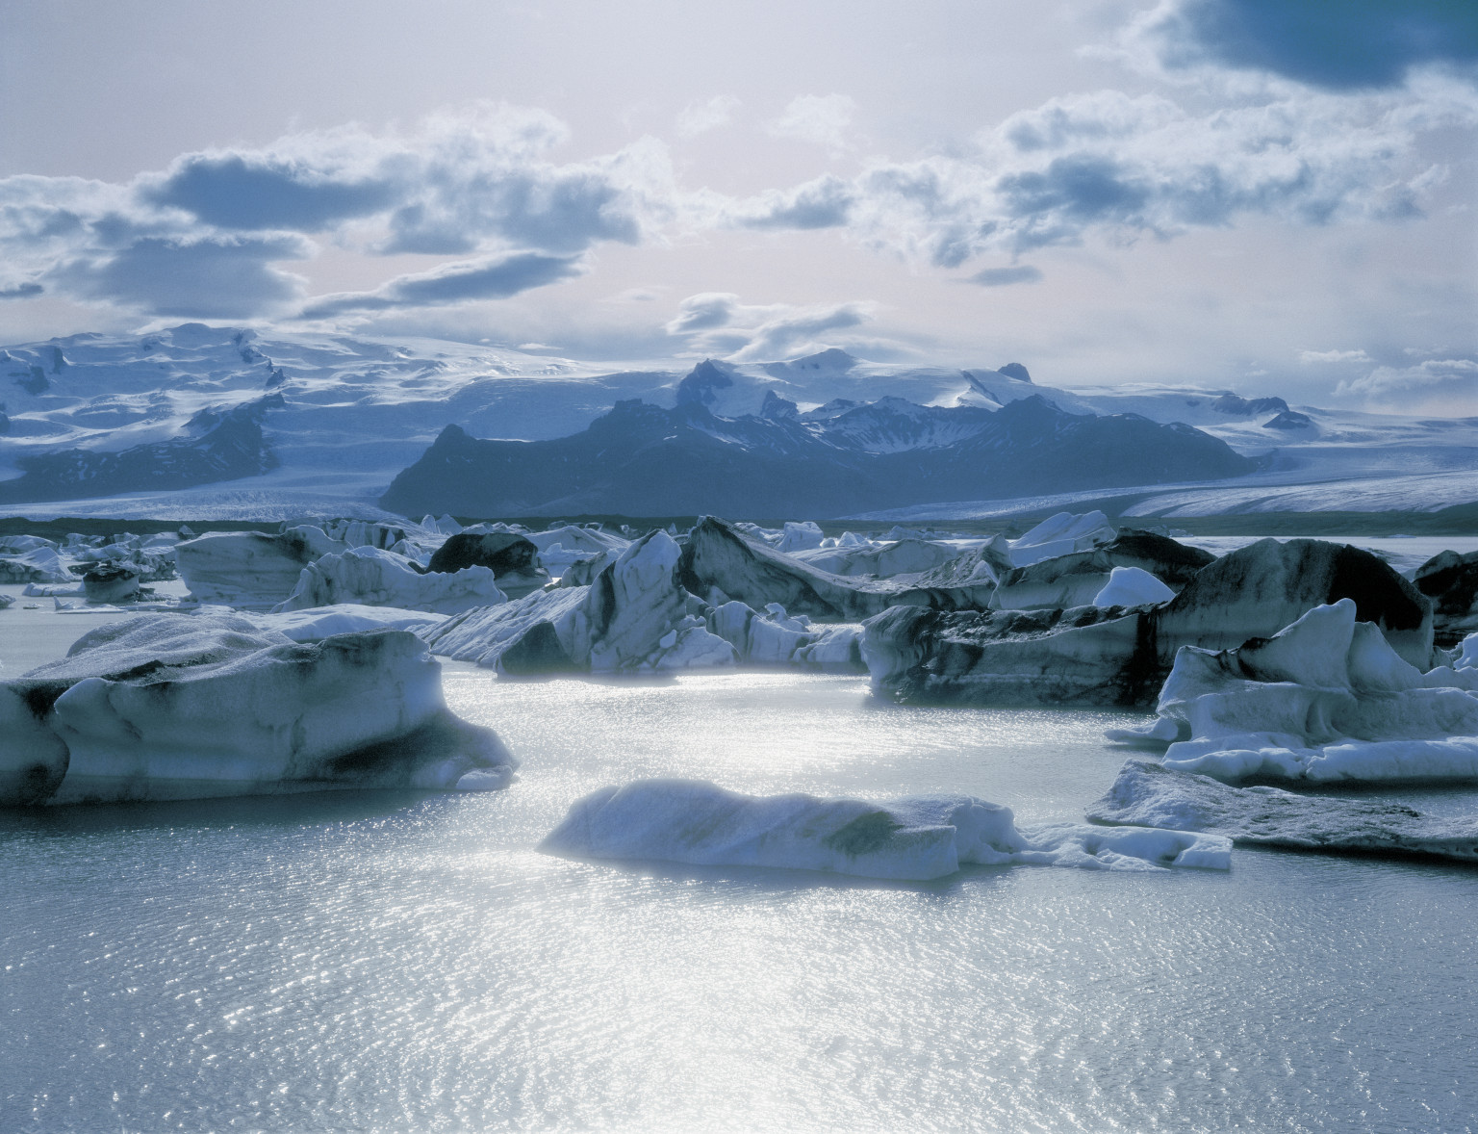
Habitat
Most of us may already know that the habitat of the polar bears is the Artic region .Polar bears have adapted to be able to live in the water and on land. Unlike other bear species, the polar bear are excellent swimmers, and have been spotted more than 100 miles away from land or ice. Over 40 per cent of all polar bears living today live in Northern Canada. Polar bears mostly eat seals and fishes. Since polar bears have such sharp nails it is able to catch fishes more quickly, that’s why it is a common food source to the polar bear.

Slide 3
What is the county/continent is this animal located
Polar bears live In the Arctic in areas where they can hunt for there food, There are five nations with polar bears such as: U.S. (Alaska), Canada, Russia, Greenland, and Norway. Polar bears do not live in Antarctica.

Slide 4
6 facts about polar bears
1.Adult females often weigh between 500 and 600 pounds (227 and 272 kilograms).
2.Polar bears fur is oily and water repellant. Allowing them to shake dry after swimming.
3.Polar bears can swim up to 100 miles (161 kilometers at a time). Polar bears can swim an average of 6 miles per hour.
4.Polar bear babies weigh a little more than a pound when they are born
5.Adult males can grow to be 10 feet tall and weigh over 1400 pounds.
6.Man made pollution is a cause of death for polar bears

Slide 5
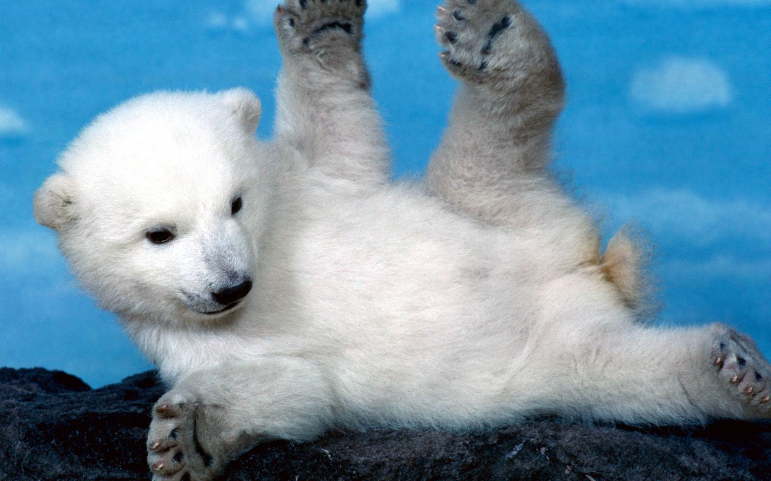
Why did the polar bears become endangered
Because of ongoing and potential loss of their sea ice habitat resulting from climate change, polar bears were listed as a threatened species in the U.S., across their range, under the Endangered Species Act in May 2008.
Polar bears are at the top of the food chain and have an important role in the overall health . Over thousands of years, polar bears have also been an important part of the cultures and economies.Polar bears depend on sea ice for there survival

Slide 6
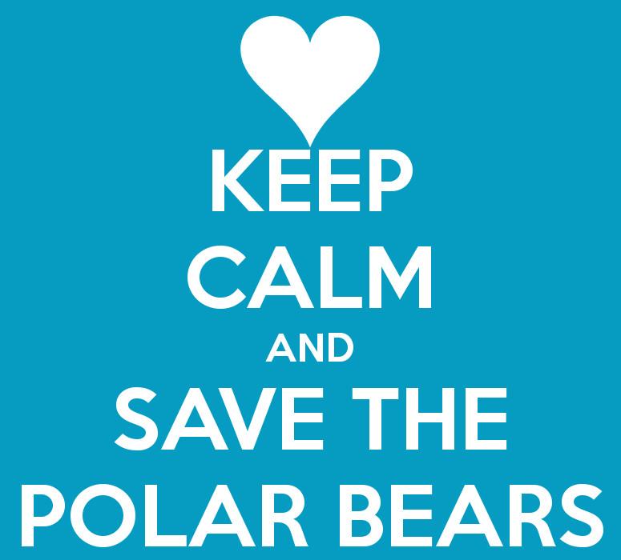
What can people do to save this animal
1. People can spread the word and help to donate, if one person tells someone, then the person who was told will tell another person and soon couple of hundreds people will find out. Remember one person makes a difference!!
2. Help stop global worming you can try car pooling, also if you want to go to near place just walk instead of using a car, this way if you help stop global worming the ice will not melt in the Artic
3. Also you can adopt a polar bear on WWF for 9 dollars a month it can save more polar bear lives this way they will not be extinct

Slide 7
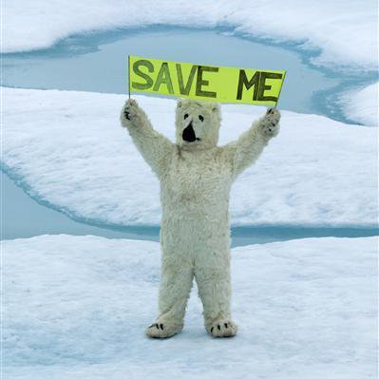
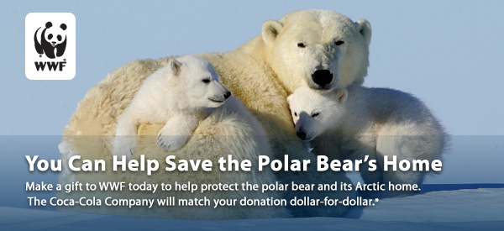
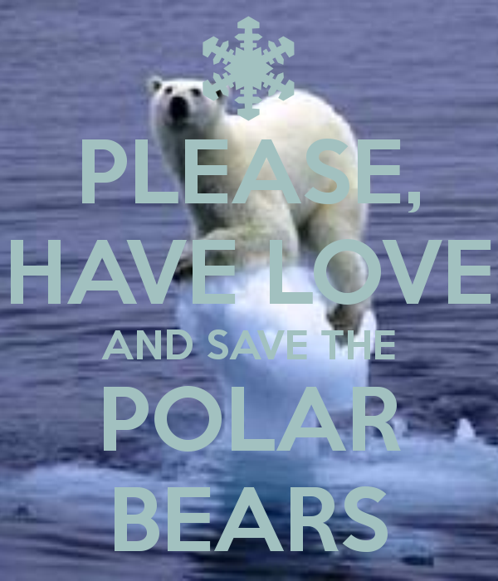
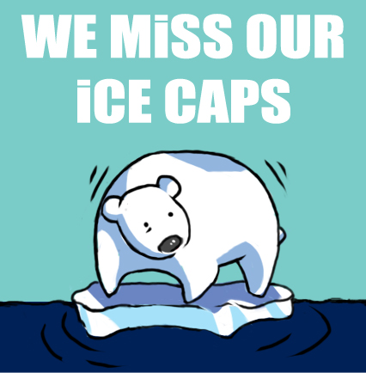
DON’T GIVE UP ON IT, PLEASE EVERYONE CAN HELP ONE PERSON CAN MAKE A HUGE DIFFRENCE, IF WE DON’T TAKE ACTION NOW MAYBE IN 2 YEARS OR LESS THEY WILL BE GONE.
WE AS HUMANS NEED TO STOP BEING SELFISH AND THING ABOUT THE OTHERS, JUST BECAUSE THERE NOT HUMANS DOESN’T MEAN WE TREAT THEM LIKE THIS.
WE ARE ALL ALLAHS CREATURES AND WE ALL DESERVE THE SAME RESPECT

