Slide 1
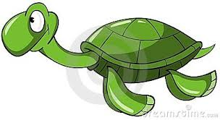
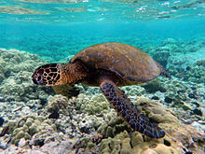
The Green Sea Turtle
e
By: Sara Atcha 7b

Slide 2
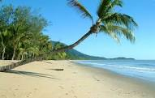
Habitat
Green sea turtles move across three habitats, depending on their stage in life. They lay eggs on beaches. Mature turtles spend most of their time in shallow, coastal waters with seagrass. While adults are in bays and lagoons with seagrass meadows.

Slide 3
Continent And Country
Green Sea Turtles live in the Atlantic, Pacific, and Indian oceans. Staying mainly in tropical and sub-tropical waters. Examples include, the East and west coasts of Florida, the Caribbean, Costa Rica, and off the Pacific coast of Mexico. Some Green Sea Turtles though live in the waters in and around Hawaii. Hawaiian Sea Turtles stay in and around the Hawaiian waters for their entire lives, though other Sea turtle populations migrate.

Slide 4
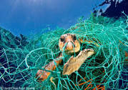
Why Is It Endangered?
Poaching
Egg harvesting
Caught in fishing nets
Pollution
Real estate development creates habitat loss
Hunting

Slide 5
How Can We Help?
Reduce the amount of chemicals we use that can get dumped into the ocean
Not litter on beaches where they can get washed into the ocean and be mistaken for food
Avoid using artificial light on beaches which can mislead turtles from the ocean

Slide 6
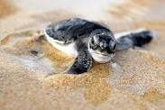
Interesting Facts
Green Sea Turtles are the largest of the hard-shell sea turtles
Green sea turtles lay 100-200 eggs at a time
These turtles can not retract their heads into their shells
They can stay under water for 5 hours (approx)
Very few baby sea turtles survive

Slide 7
By: Sara Atcha.

