Slide 1
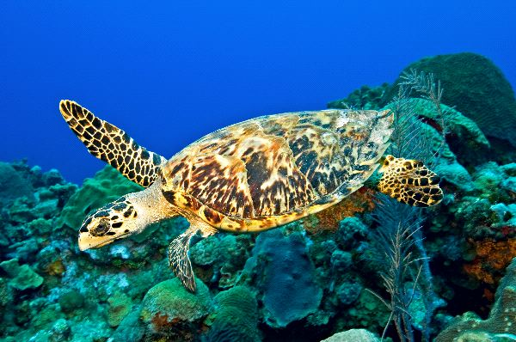
HAWKSBILL SEA TURTLE
Taahir Shaffee

Slide 2
What is the name of the animal?
What is the animal’s habitat?
What country/continent is this animal located?
What are some interesting facts about this animal? (5 facts)
What has caused this animal to become endangered?
What can people do to help save this animal? (3 reasons)

Slide 3
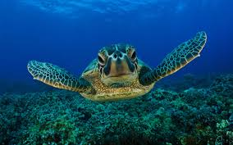
What is the name of the animal?
To the world, the name of the animal that I am researching is more commonly known as the Hawksbill Sea Turtle, but the name of this animal scientifically is the Eretmochelys Imbricata. The reason that the Hawksbill Sea Turtle’s name is as such is because of its narrowly shaped head and hawk-like beak.

Slide 4
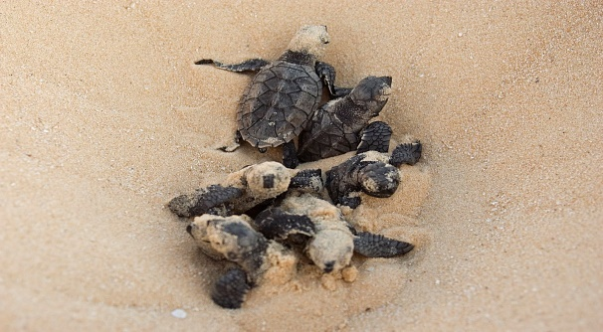
What is the animals habitat and what country/continent is it located?
The Hawksbill Sea Turtle’s habitat is usually a coral reef in the sea. They would ususally live in the caves of the coral reefs or any small ledges that they can find in coral reefs. The Hawksbill Sea Turtle doesn’t actually live in any countries or continents, since it’s a SEA Turtle, but it obviously lives in the oceans. The oceans that the Hawksbill lives in are the Atlantic Ocean, the Indian Ocean, and the Pacific Ocean. Those are the 3 main areas that the Hawksbills live in.

Slide 5
What are 5 interesting facts about this animal?
The Hawksbill Sea Turtle can live up to 50 years! (Longer than your cat =D)
The heaviest Hawksbill Sea Turtle ever caught was a whopping 127 kg! (280lb)
The Hawksbill Sea Turtle’s narrow head helps it gather food from narrow crevices.
Hawksbill Sea Turtles eat sponges, anemones, squid and shrimp. Delicious Delicacies!
The Hawksbill Sea Turtle has many colours on it’s shell, like brown, yellow, orange, red, and maybe even more!

Slide 6
What has caused this animal to become endangered?
Even though it’s illegal in many countries, the Hawksbill Sea Turtle is caught by humans throughout the world, and used for unnecessary reasons. In some countries, they are eating Hawksbills as a delicacy, even though they are going to disappear from the world soon. Also, because of the Hawksbill’s unique shell, their shells are being used for decoration in some countries as well.

Slide 7
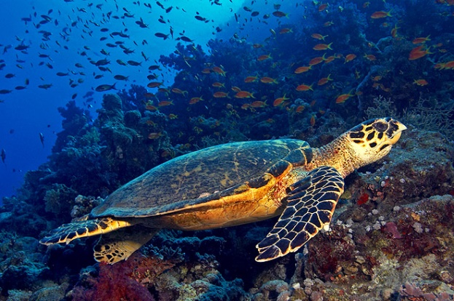
What are 3 things that people do to help save this animal?
If people would stop eating the Hawksbills in some countries, then the population of them wouldn’t decrease so much.
As long as people keep using the shells of the Hawkbills for something as simple as decoration, then Hawksbills are on the verge of extinction, so people in countries should stop

Slide 8
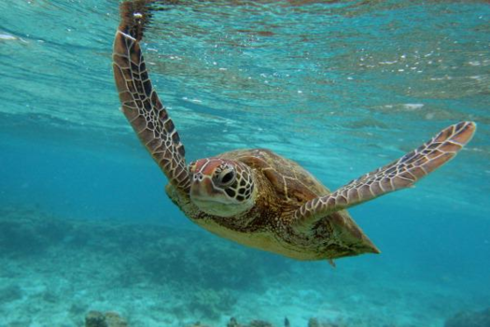
The most important thing of all is that people should stop CATCHING Hawksbills, then there would be many in the ocean. Unfortunately, humans just keep catching them. That’s why it’s banned in some countries.
It doesn’t help that the process of giving life to a Hawksbill is so slow, so we really need to stop doing these horrible things to Hawksbills.

Slide 9
Hopefully, from what you’ve learned about the Hawksbill Turtle just now, you see them in a different light and want to help them. Only you can make a difference so please, help the Hawksbill Sea Turtle!
THE END!

