Slide 1
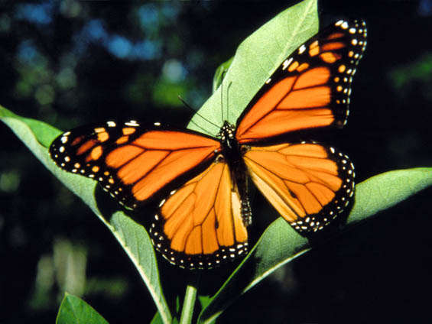
Monarch Butterflies

Slide 2
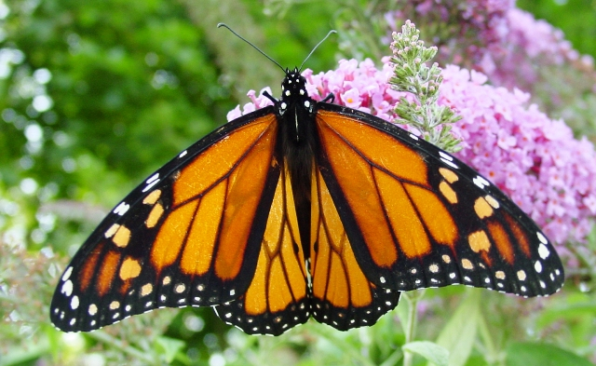
Introduction to my animal
Welcome to my project about endangered species. The animal that I chose for this project was the Monarch butterfly. I chose this animal because I want to inform you people of how the Monarch butterflies are being decreased in population. This means that this type of species are endangered. Being endangered means a species of animals or plants with a very high risk of extinction

Slide 3
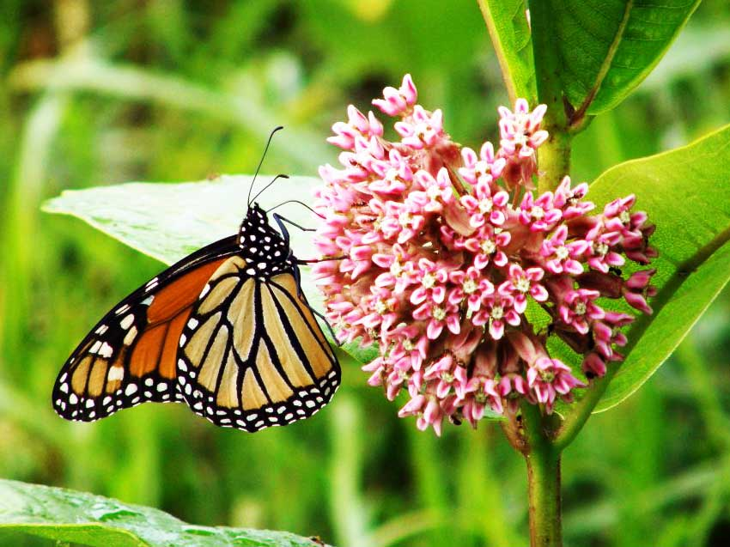
Habitat
The habitat of the monarch butterfly would be anywhere in summer or spring with open fields and meadows with milkweed, but when it is winter they are used to migrate to California or high altitudes of southern Mexico. .

Slide 4
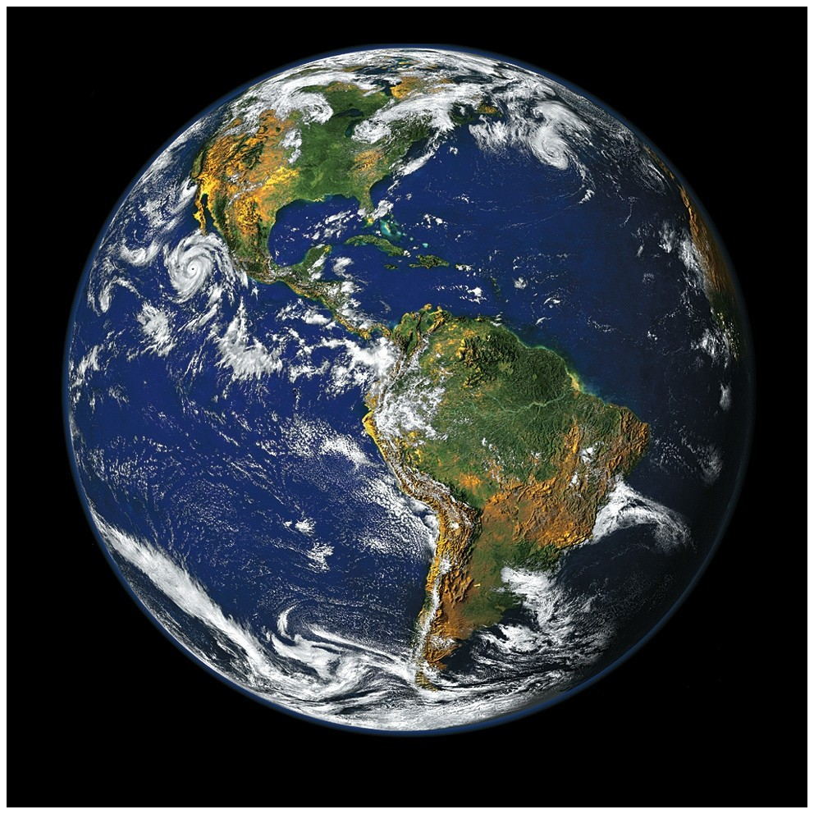
Country it is found in
The exact country(s) that Monarch butterflies would be spotted in are America (California, Texas, and Florida), and Mexico. The Monarch butterflies have a different species in New Zealand also. The continent that most of the butterflies come from is North America.

Slide 5
Interesting Facts
The interesting facts that I will talk to you about are……….
1.)Monarch Butterflies fly about 3000 miles to migrate
2.)Monarch Butterflies have a life span of 6-8 months
3.)Monarch Butterflies have one of the biggest migration of any other animal species.
4.)Monarch Butterflies are poisonous insects so it has less predators.
5.)Monarch Butterflies can see UV light that we cannot.

Slide 6
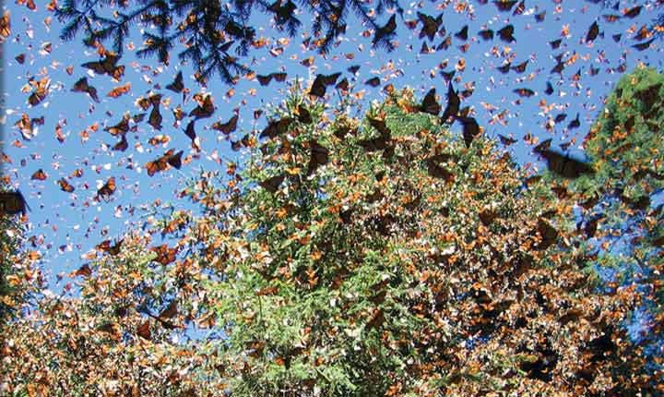
How it is Endangered
Monarch Butterflies are endangered because of severe weathers and climate change for example the summer ground would start to get colder and also rain, the Monarch Butterflies are disrupted by these weather conditions and freeze to death. Also the food that they consume comes from milkweed bushes and they are slowly decreasing too. Another reason why monarch butterflies are endangered is that there is too much pollution this causes the animal to get a disease and die.

Slide 7
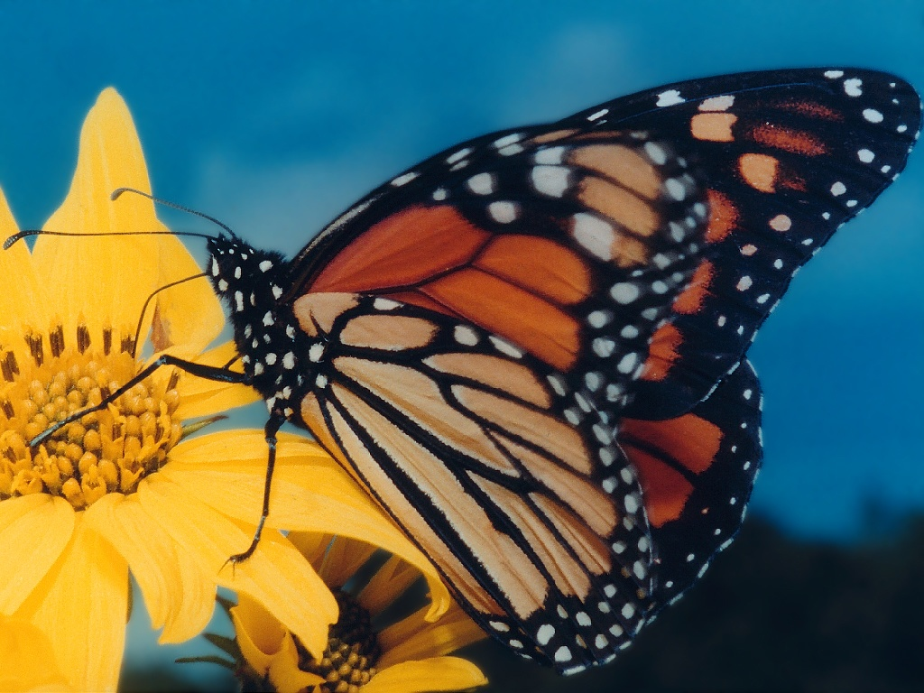
How we can help save them
What we should do to not let the Monarch Butterfly go extinct would be to make separate habitats for them in countries where it is very warm and not the season of fall or winter. The second thing we could do would be to plant more bushes of milkweed so the butterflies can have a proper diet. Also the third and last thing I wanted to say to help the monarch butterflies was to not buy in overdevelopment this will help them because with less factories there will be less pollution so the monarch butterflies can breathe fresh air like us humans.

Slide 8
Thank you for listening to my project/assignment about endangered species and
Assalamualaikum!
By: Waleed Malik

