Slide 1
Monarch butterfly
By: Zaneeta Rahman

Slide 2
The monarch butterfly
The monarch butterfly is a milkweed butterfly. The scientific name is Danaus plexippus (subfamily Danainae) in the family Nymphalidae.
Its wings feature an easily recognizable orange and black pattern, with a wingspan of 8.9–10.2 cm (3½–4 in).
Kingdom: Animalia
Phylum: Arthropoda
Class: Insecta
Order: Lepidoptera
Family: Nymphalidae
Tribe: Danaini
Genus: Danaus
Species: D. plexippus

Slide 3
habitat
During breeding season it can be found in agricultural fields, pasture land, prairies, urban and suburban living areas, gardens, trees, and roadsides - anywhere where there is to larval host plants.
What this shows that it can be anywhere, where there is lots of land and plants.

Slide 4
Interesting facts
DID YOU KNOW:
Monarch butterfly travels in a speed of 12 to 25 miles per hour.
The monarch butterfly does breaths through tiny vents in the thorax or abdomen called spiracles, and tubes called trachea. This tube spreads oxygen throughout the body.
They flap slower compared to any other butterflies. They flap about 300 to 720 times a minute.
Adult monarchs drink nectar and water by sipping on it using a small tube called proboscis, that is together with the head when not in use.

Slide 5
where it lives
Migrating groups of D. plexippus are found in places like: Mexico, California, along the Gulf coast, in Florida, and specially in Arizona. Because it is where the habitat provides their need for their survival.
The migrating habitat gives access to streams, lots of sunlight (preparing them for a long journey), food to eat , and is moderately free of predators. in this journey, roosting butterflies have been seen on these plants : sumacs, locusts, basswood elm, oak, osage orange, mulberry, pecan, willow, cottonwood, and mesquite.

Slide 6
Why endangered
Climate is the reason to disrupt the monarch butterfly’s annual migration pattern. Affecting climate conditions in both wintering grounds and summer breeding grounds. Colder, wetter winters could be lethal to these creatures and hotter, drier summers could shift suitable habitats north.
This measured by the number of forest they occupy, and in the year 2013 the number of butterfly acres decreased from approximately seven to three. Unusual patterns of drought and rainfall in the U.S. and Canada’s breeding sites which caused adult butterfly deaths and less food for caterpillars. Fewer butterflies up north mean fewer then migrate south to Mexico for the winter.
HABITAT LOSS
Monarchs need mountain forests in Mexico for their winter habitat, however nearby human communities also rely on them through agriculture and tourism activities.

Slide 7
Save it
We can save this beautiful unique specie by letting them be in their own habitat.
We can limit the amount of logging and cutting trees so they can use it.
Global warming is also affecting them.
We can stop and help nature.
Preserving this creature can stop it from being extinct.

Slide 8
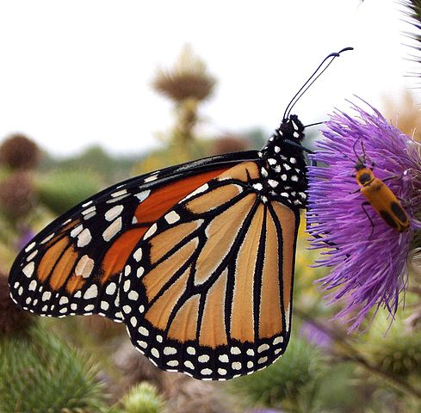
Thank you☺ save the monarch
By: Zaneeta Rahman

